Slide 1
Week at A Glance for Science
February 27-
March 3
Solar System and Beyond

Slide 2
February 27 – March 3
S6E1. Obtain, evaluate, and communicate information about current scientific views of the universe and how those views evolved.
a. Ask questions to determine changes in models of Earth’s position in the solar s
c. Analyze and interpret data to compare and contrast the planets in our solar system in terms of:
- size relative to Earth,
- surface and atmospheric features,
- relative distance from the sun, and
-ability to support life.

Slide 3
February 27 – March 3
S6E1. Obtain, evaluate, and communicate information about current scientific views of the universe and how those views evolved.
a. Ask questions to determine changes in models of Earth’s position in the solar system, and origins of the universe as evidence that scientific theories change with the addition of new information. (Clarification statement: Students should consider Earth’s position in geocentric and heliocentric models and the Big Bang as it describes the formation of the universe.)
b. Develop a model to represent the position of the solar system in the Milky Way galaxy and in the known universe.
c. Analyze and interpret data to compare and contrast the planets in our solar system in terms of: • size relative to Earth, • surface and atmospheric features, • relative distance from the sun, and • ability to support life.
d. Develop and use a model to explain the interaction of gravity and inertia that governs the motion of objects in the solar system.
e. Ask questions to compare and contrast the characteristics, composition, and location of comets, asteroids, and meteoroids.

Slide 4
 | Monday 27 | Tuesday 28 | Wednesday 1 | Thursday 2 | Friday 3
Focus Standard(s) | S6E1.c | S6E1.c | S6E1.c | S6E1.c | S6E1.c
Learning Target(s) | Planets (size,distance, composition) | Planets (size,distance, composition) | Planets (size,distance, composition) | Planets (size,distance, composition) | Planets (size,distance, composition)
Opening | WB Chapter 19 | WB Chapter 19 | WB Chapter 19 | WB Chapter 19 | WB Chapter 19
Work Session | Solar System; Test #2; Missing Assignments; Relative size and distance of planets | Solar System Powerpoint; Edpuzzle; Relative size and distance of planets | Solar System Video, Solar System Animation; Stations | Relative size and distance of planets activity; Stations | Surface and atmosphere of planets posters (group activity); Stations
Closing | TOD | Think-Pair-Share | TOD | Think-Pair-Share | Class Discussion
Minor Assignments Due |  |  | Quiz #6
Major Assignments Due | Test#2 Solar System |  | R&R
Current Relearning & Reassessment Assignments (with due dates)
Vocabulary
Upcoming Major Assignments |  | Science Fair Projects Due by March 10

Slide 5
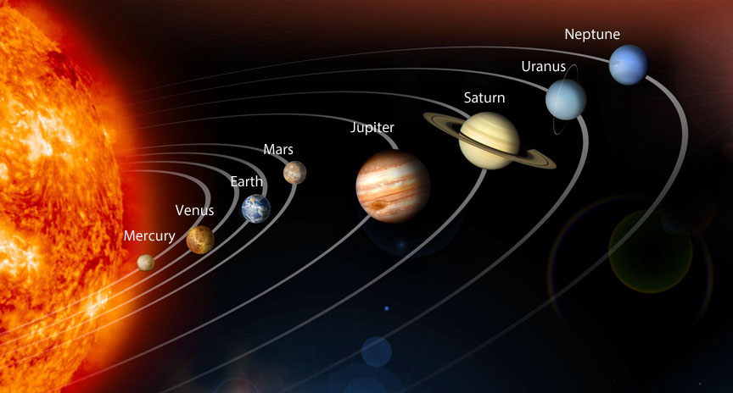

Slide 6
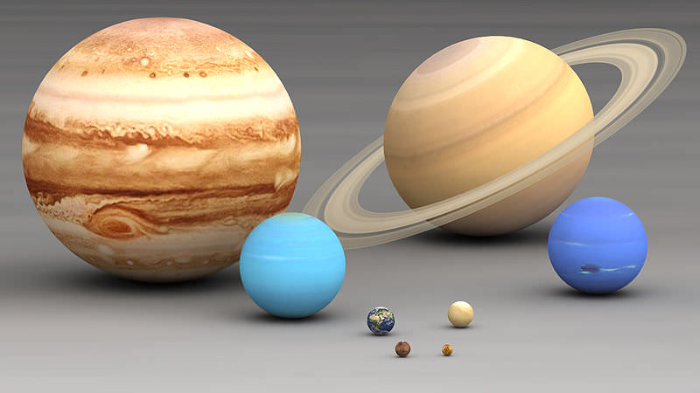
Relative Size

Slide 7
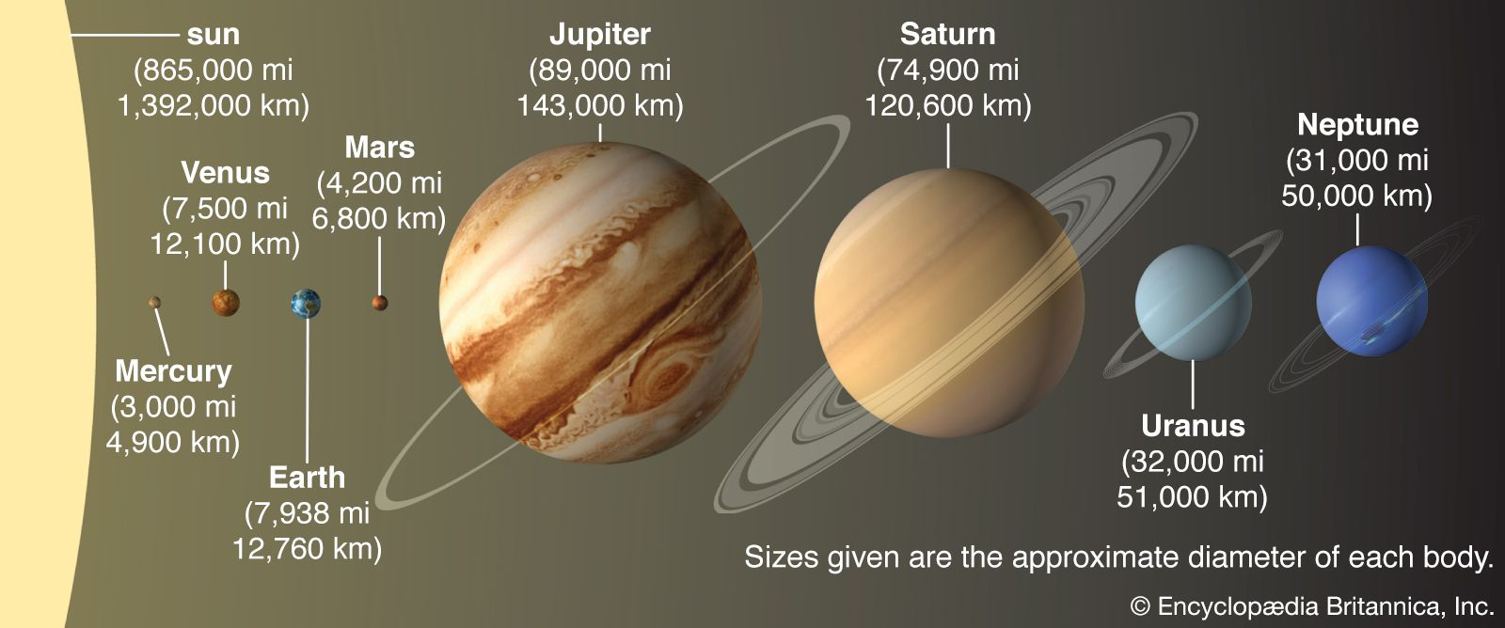
Relative Distance

Slide 9
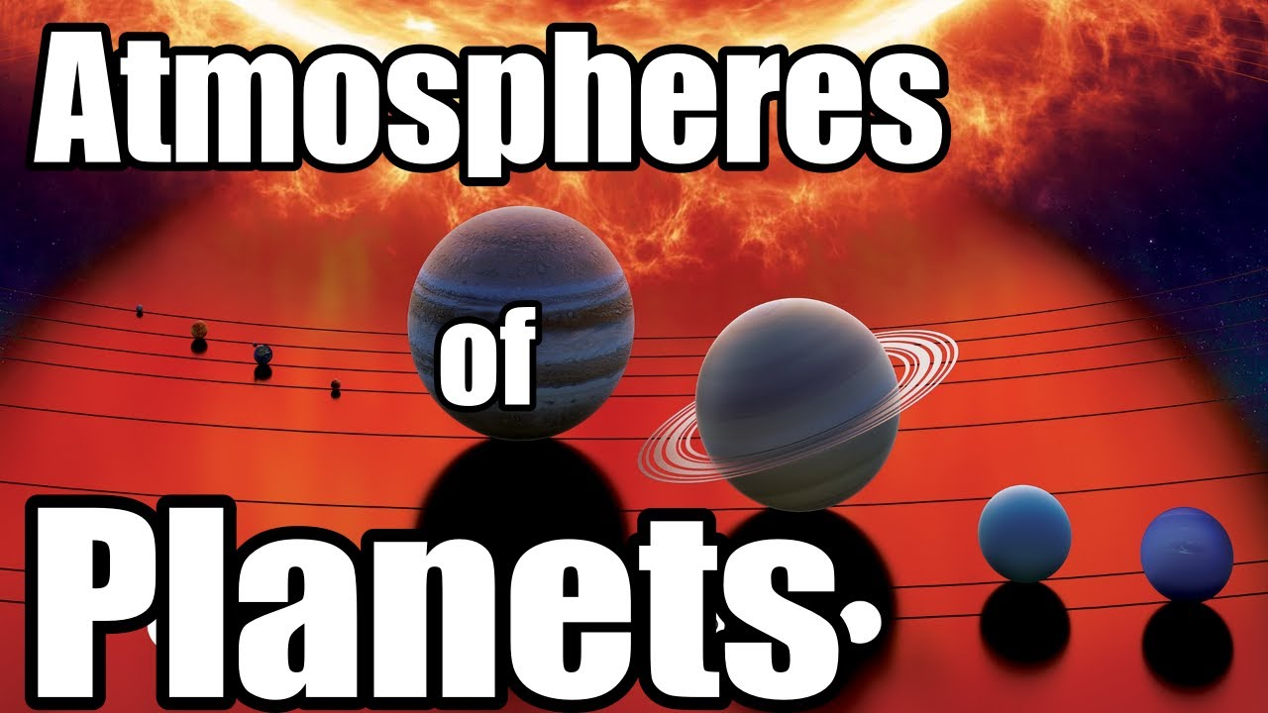

Slide 11
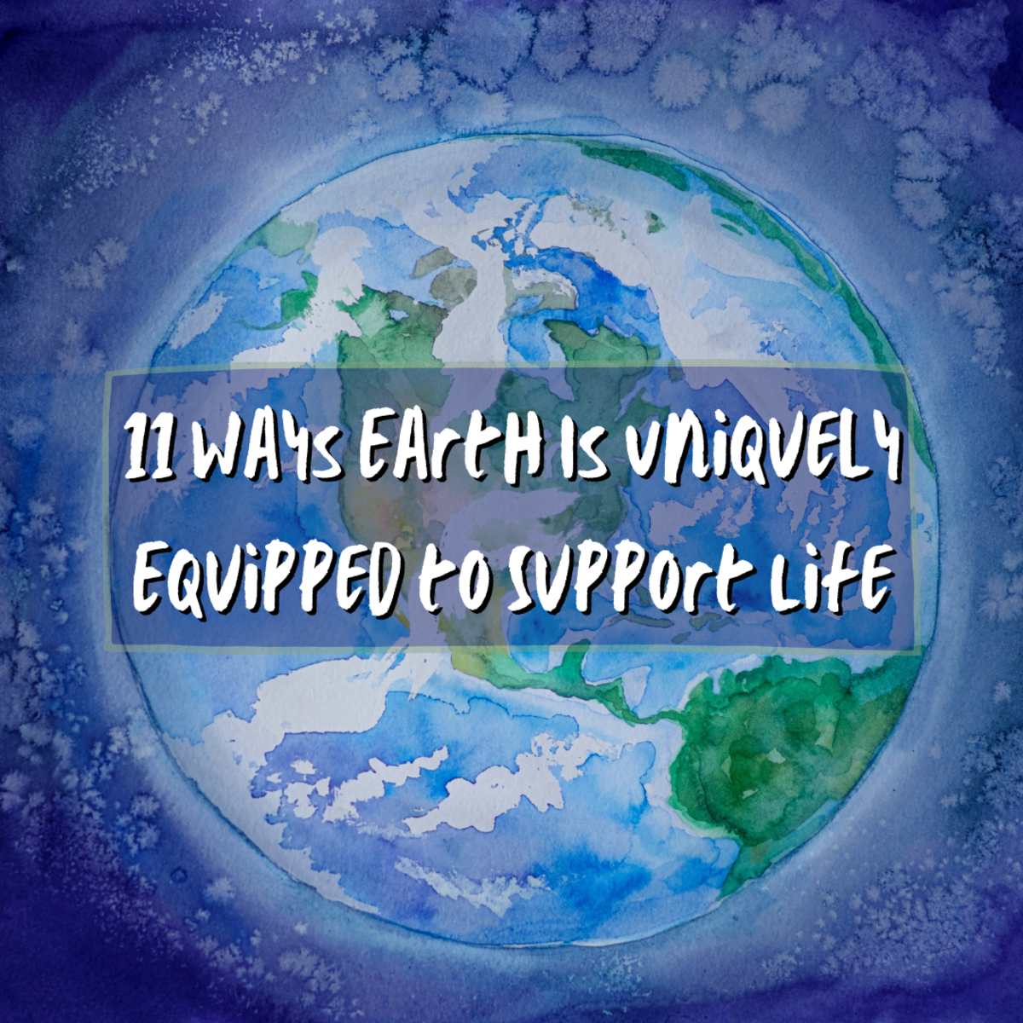
Ability to Support Life

Slide 12
Incredible Facts About The Planets In Our Solar System | Zenith Compilation | Spark
Click for video

Slide 13
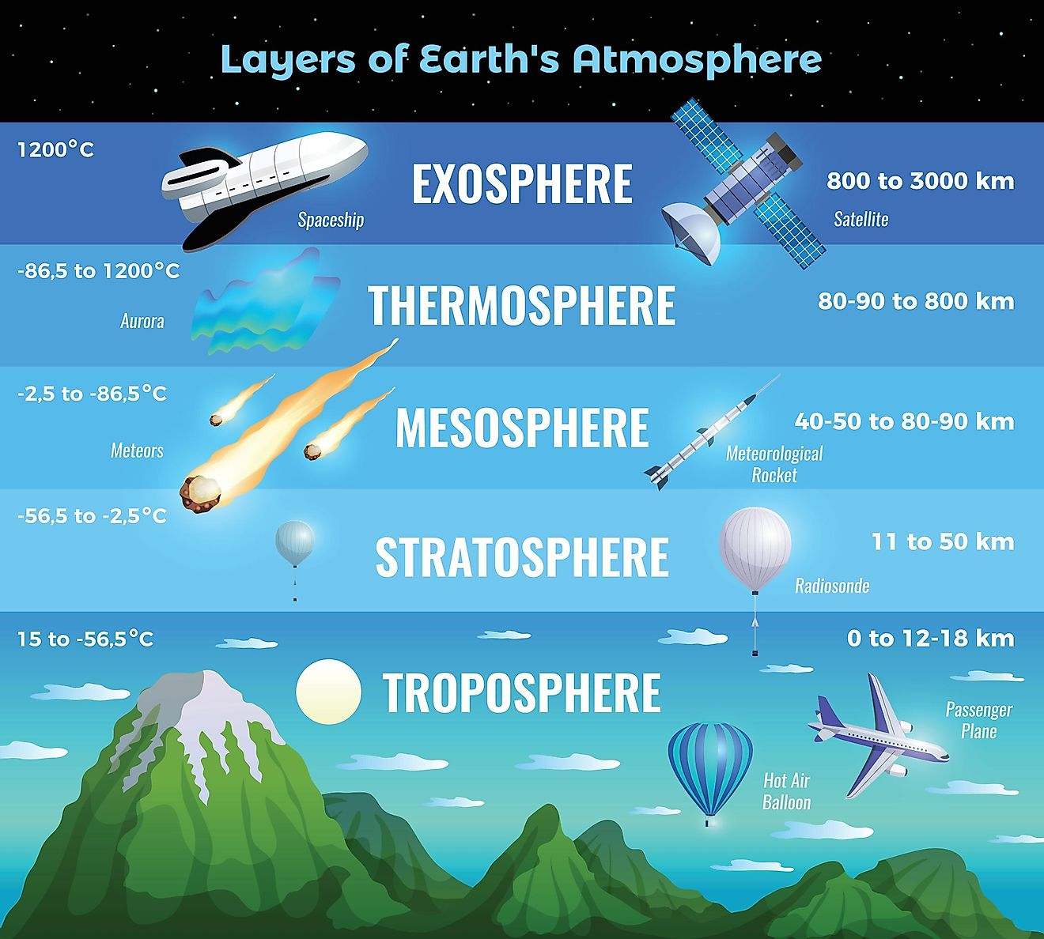

Slide 14
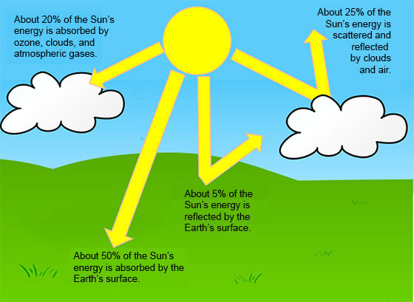

Slide 15
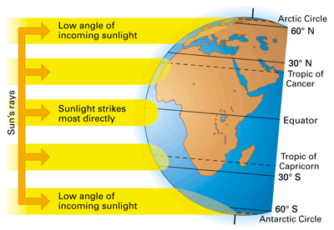

Slide 16
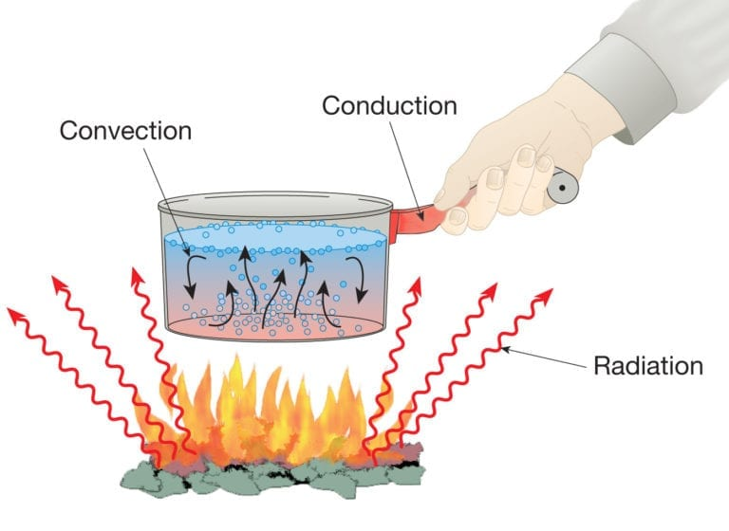

Slide 17
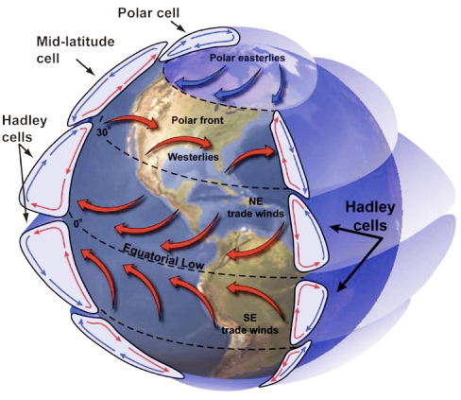
Global Wind Explained
The illustration below portrays the global wind belts, three in each hemisphere. Note that the U.S. lies primarily in the Westerly Wind Belt with prevailing winds from the west. Each of these wind belts represents a "cell" that circulates air through the atmosphere from the surface to high altitudes and back again. The cells on either side of the Equator are called Hadley cells and give rise to the Trade Winds at Earth's surface. How do we explain this pattern of global winds and how does it influence precipitation?

Slide 18
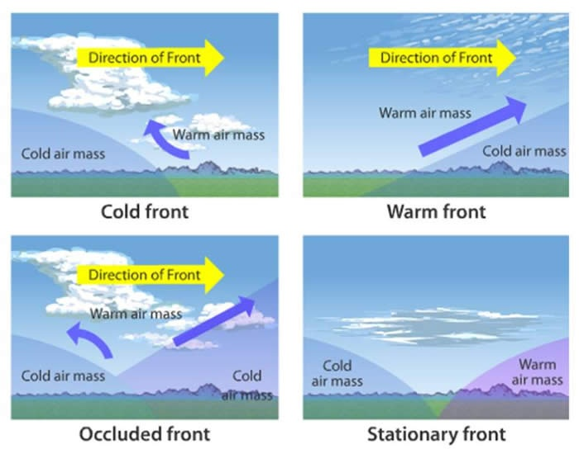

Slide 20
Students will have 15 minutes of Homework each evening.
4 Squares (usually a drawing)
Rock Cycle Puzzle
Workbook Pages
Powerpoint Study Guides
Study Notes or Study Guides
Watch Videos from Week at a Glance

